Slide 1
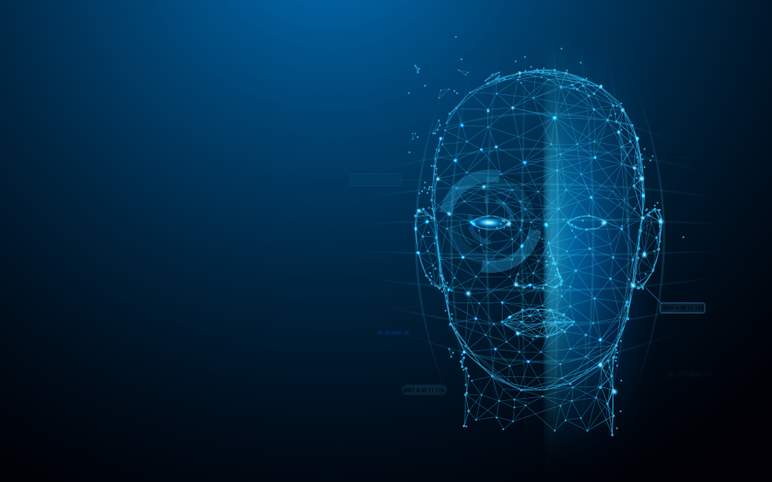
Face Recognition Attendance System
Group Member:
Tamim iqbal - 20215103109
Sheikh rabby - 20215103106
Shorna - 20215103094
Ar rafi - 20215103087

Slide 2
Introduction
As we are making a system which can recognize face and match with its own database. It will make the attendance system more authentic. Our primary goal is to help the lecturers, improve and organize the process of track and manage student attendance and absenteeism.

Slide 3
What Is Face Detection?
Face detection is a type of computer vision technology that is able to identify people’s faces within digital images. This is very easy for humans, but computers need precise instructions. The images might contain many objects that aren’t human faces, like buildings, cars, animals, and so on.

Slide 4
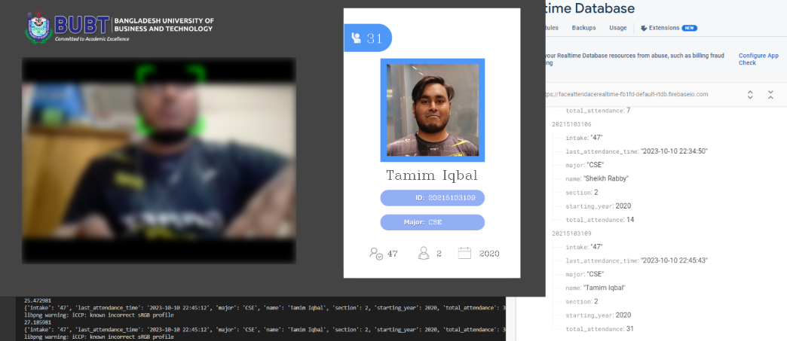
Face recognition with real-time database

Slide 5
features
1. Recognize & Attendance.
2. Download Attendance.
3. Training new faces.
4. Upload students data manually in database server.
5. Upload student face models manually in database storage.

Slide 6
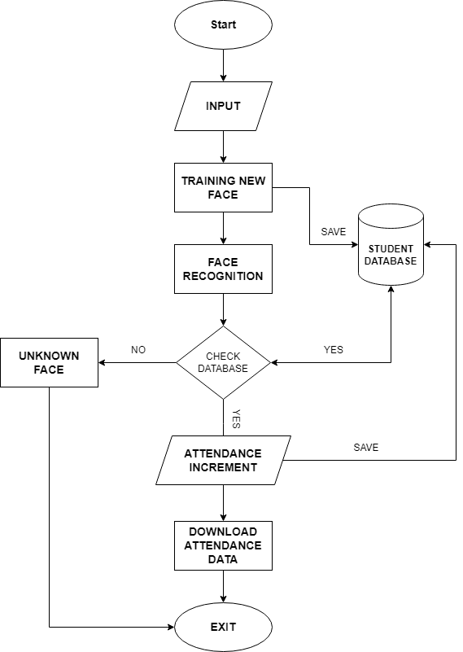
flowchart

Slide 7
Advantages
The system scans the faces from live video stream and scans them for any detection from storage images and automatically marks attendance if face is detected.
Ease of use is manipulate and recognize the faces in real time.
Database that updates real-time.
User can upload large chunks of student data in server manually.
User can download Attendance data from server.

Slide 8
Disadvantages
The accuracy of the system is not 100%. It can only detect face from a limited distance.

Slide 9
Software & tools Used
Python 3.
Google Firebase.
Vscode.
iVcam.

Slide 10
Use of opencv face to recognize faces.
The idea behind this technique involves using a cascade of classifiers to detect different features in an image. These classifiers are then combined into one strong classifier that can accurately distinguish between samples that contain a human face from those that don’t.
The Haar Cascade classifier that is built into OpenCV has already been trained on a large dataset of human faces, so no further training is required. We just need to load the classifier from the library and use it to perform face detection on an input image.

Slide 11
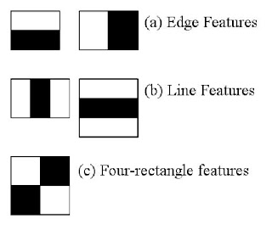
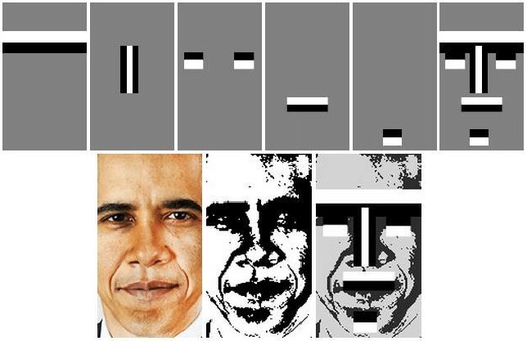
Face detection - haar cascade(Viola-Jones Algorithm)
The Viola-Jones algorithm is a widely used and highly efficient object detection framework, particularly known for its role in face detection. It was developed by Paul Viola and Michael Jones and introduced in their paper titled "Rapid Object Detection using a Boosted Cascade of Simple Features" in 2001. The algorithm leverages Haar-like features, AdaBoost, and a cascade of classifiers to achieve real-time object detection.
During the detection process, the Haar Cascade Classifier slides a window of various sizes over the image and applies the cascade of classifiers at each position. If an object is detected in the image, it is reported as a bounding box around the object's location.

Slide 12
Why use Viola-Jones Algorithm?
The Viola-Jones algorithm is known for its speed and efficiency, making it suitable for real-time applications like face detection in video streams or images. It has also been adapted for the detection of various objects other than faces, such as eyes, vehicles, and more. The ability to quickly eliminate non-object regions using the cascade of classifiers makes it a practical choice for many computer vision applications.

Slide 13
Result Analysis
In our project we have been working less than 5 pictures. it is not enough.
We need to use more than 1000+ pictures to fully calculate the accuracy result.
To make almost 100% accurate we need to use more powerful hardware and also need more resources.

Slide 14
Future works
In future, we are going to make our project online. So that this project can be use in bigger area like University, work place , factory etc. And also add the neural network or deep learning. If we use the neural network we can have more accuracy around 99.9% with big datasets.

